Slide 1
CIS 200 Search Algorithms
7 August 2018
Jeffrey J. Yackley

Slide 2
Outline
Search Algorithms
Linear Search
Binary Search
Hashing
Other Search Functions

Slide 3
Two Fundamental Algorithm Categories
Search Algorithms: determine whether the number x is in the list S of n numbers
Sort Algorithms: order a list S of n numbers in some (decreasing/increasing/other) order.

Slide 4
Sequential / Linear Search
Search Problem: determine whether the number x is in the list S of n numbers
A simple approach to solve the search problem is to do sequential search, i.e.,
Start from the leftmost element of S and one by one compare x with each element of S
If x matches with an element, return the index.
If x doesn’t match with any of elements, return -1.

Slide 5
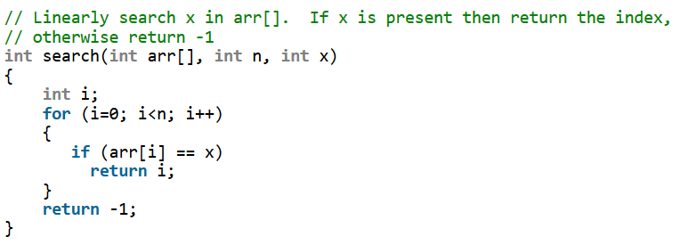
Sequential Search C++
https://www.geeksforgeeks.org/linear-search/

Slide 6
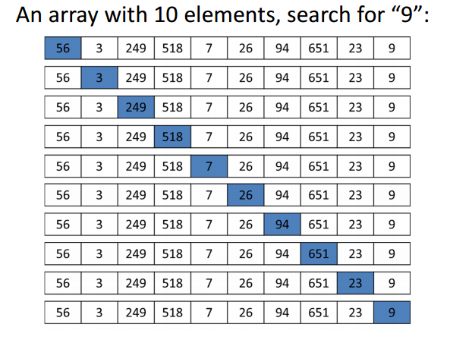
An Example: Sequential Search
Start:
Begin at array[0]
Check if array[0] == x
If so return true or position in array
Otherwise check next element until end of array
If not in list return false or -1

Slide 7
Sequential Search Analysis
Worst Case: N comparisons = O(n)
Best Case: 1 comparison = O(1)
Average Case: harder to compute
If successful: (n + 1) / 2
If unsuccessful: n
if combined (using probability) : simplifies to O(n)

Slide 8
Outline
Search Algorithms
Linear Search
Binary Search
Hashing
Other Search Functions

Slide 9
Binary Search
Search a sorted array by repeatedly dividing the search interval in half
Strict requirement for the algorithm: must be sorted
Begin with an interval covering the whole array
If the value of the search key is less than the item in the middle of the interval, narrow the interval to the lower half
Otherwise narrow it to the upper half
Repeatedly check until the value is found or the interval is empty

Slide 10
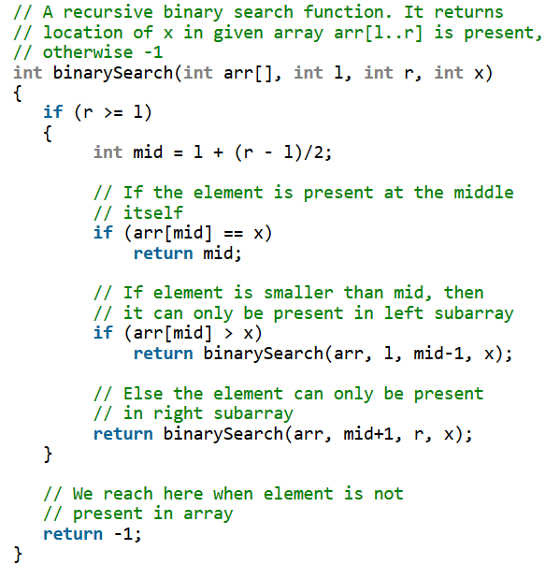
Binary Search in C++ (Recursive)
https://www.geeksforgeeks.org/binary-search/

Slide 11
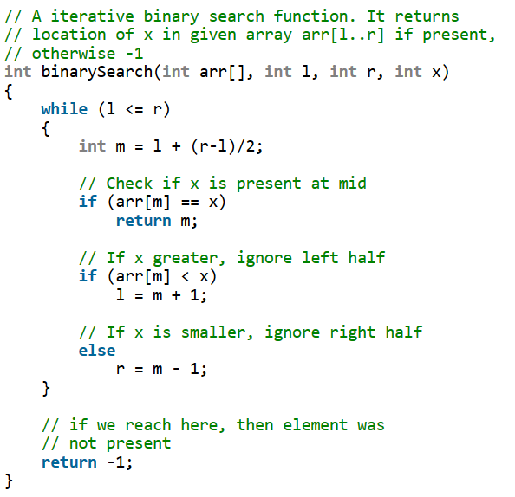
Binary Search in C++ (Iterative)
https://www.geeksforgeeks.org/binary-search/

Slide 12
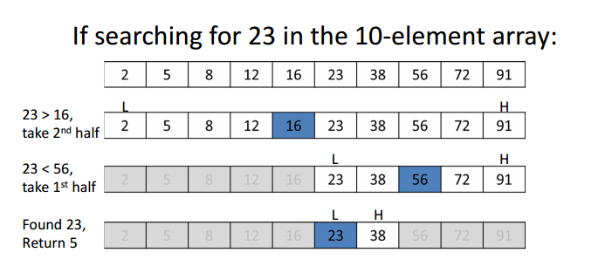
Binary Search: An Example

Slide 13
Binary Search: Another Example

Slide 14
Binary Search Analysis
Worst Case: O(log n)
Solved time complexity function T(n) = T(n/2) + 1 with Master method
Best Case: 1 comparison = O(1)

Slide 15
Comparing Linear and Binary Search
Array size | Sequential Search | Binary Search
128 | 128 | 8
1,024 | 1,024 | 11
1,048,576 | 1,048,576 | 21
4,294,967,296 | 4,294,967,296 | 33

Slide 16
Outline
Search Algorithms
Linear Search
Binary Search
Hashing
Other Search Functions

Slide 17
Hashing
Suppose designing a phone-book application.
Could store all the numbers in an array
Problems?

Slide 18
Hashing
Suppose designing a phone-book application.
Could store all the numbers in an array
Problems:
Gigantic array needed for all the possible phone numbers
Not efficient if we need to find a number or insert/delete a number
Why?

Slide 19
Hashing
Suppose designing a phone-book application.
Could store all the numbers in an array
Problems:
Gigantic array needed for all the possible phone numbers
Not efficient if we need to find a number or insert/delete a number
Linear search O(n): can deal with sorted/unsorted lists
We might have to search whole array!
Binary search O(log n): can ONLY work with sorted lists
We need to put a lot of effort in to maintaining the list (insert/delete becomes very expensive operations)
Does a better method exist?

Slide 20

Hashing
Hashing: A better method

Slide 21
Hashing
Hashing: A better method
We use a special function (Hash Function) to converts a phone number to a smaller number.
This smaller number is than used as the index in a table (Hash Table).

Slide 22
Hash Functions
Two properties for a good function:
Efficiently computable
Uniformly distribute the keys
Bad: Use the first three digits of a number
Better: Last three digits of a phone number
Possibly better may exist.

Slide 23
Hash Tables
An array that stores pointers to phone numbers
Problem: What happens when we try to store two keys in the same value?
Collision Handling:
Chaining: Make each cell of hash table point to a linked list of records that have same hash function value
Simple, but requires additional memory outside the table
Open Addressing: Each table entry contains a record or NIL (not in list)
Every stored in table

Slide 24
Hashing Example

Slide 25
Hashing Example

Slide 26
Hashing Example

Slide 27
Hashing Example

Slide 28
Hashing Example

Slide 29
Hashing Example

Slide 30
Hashing Example

Slide 31
Clustering
The tendency of elements to become unevenly distributed in the hash table, with many elements clustering around a single hash location.
Results from collisions.
Solutions:
Linear probing with a constant
(HashValue + constant) % array_size
Quadratic probing
(HashValue + I²) % array_size
I is number of times that the rehash function has been used
Random probing
Uses a pseudo-random number generator to determine the increment to HashValue
Bucket or Chain
A bucket or a linked list of elements that share the same hash location

Slide 32
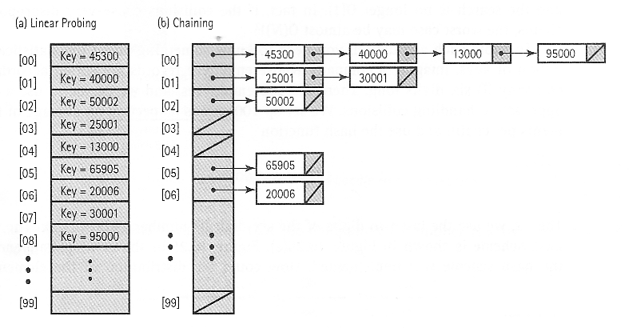
Clustering

Slide 33
Hashing Search Analysis
Worst Case: O(n)
Best Case: 1 comparison = O(1)
Average Case: O(1)

Slide 34
Outline
Search Algorithms
Linear Search
Binary Search
Hashing
Other Search Functions

Slide 35
Other Search Functions
Many search functions exist
(CIS 275/350/405/479)
Tree / Graph
Breadth First Search
Depth First Search
Best First Search
A*
Branch and Bound

